Slide 1
What should you know
HTML
CSS
Basic Javascript
Programming fundamentals(functions, conditions, loops, etc)
AngularJS vs Angular 2x, 3x, 4x…

Slide 2
What is Angular 2
Angular 2 is client side javascript framework for creating power web applications.
Created and maintained by Google.
The most popular javscript framework up to date.
What HTML would be if it were created for dynamic web applications

Slide 3
What Angular 2 is not
A server side framework/technology.
Javascript library (Jquery, React)
Design Pattern
Plateform or language (.Net, Java)
Plugin or extension

Slide 4
What Angular 2 Offers
Form and input handling
Event handling
Routing
Latest javascript standards
Much more
Dynamic HTML
Powerful templates
Fast rendering
Http Services
Component encapsulation
Form and input handling

Slide 5
FEATURES & BENEFITS
Cross Platform
Progressive web apps
Use modern web platform capabilities to deliver app-like experiences. High performance, offline, and zero-step installation.
Native
Build native mobile apps with strategies from Ionic Framework, NativeScript, and React Native.
Desktop
Create desktop-installed apps across Mac, Windows, and Linux using the same Angular methods you've learned for the web plus the ability to access native OS APIs.
Speed and Performance
Code generation
Angular turns your templates into code that's highly optimized for today's JavaScript virtual machines, giving you all the benefits of hand-written code with the productivity of a framework.
Universal
Serve the first view of your application on node.js, .NET, PHP, and other servers for near-instant rendering in just HTML and CSS. Also paves the way for sites that optimize for SEO.
Code splitting
Angular apps load quickly with the new Component Router, which delivers automatic code-splitting so users only load code required to render the view they request.

Slide 6
Wha’s new from Angular 1?
No more controllers and scope
Components / reusable code
Reduced learning curve
Typescript & ES 2015/ ES6
Better mobile support
RxJs & Observrables

Slide 7
What is Typescript
A strict superset of javascript with added features
Maintained by Micrsoft
Optional static typing
Class based object oriented programming
Resembles languages like Java and C/C++

Slide 8
The basic building blocks of Angular applications.
Angular is a framework for building client applications in HTML and either JavaScript or a language like TypeScript that compiles to JavaScript.
The framework consists of several libraries, some of them core and some optional.
You write Angular applications by composing HTML templates with Angularized markup, writing component classes to manage those templates, adding application logic in services, and boxing components and services in modules.
Then you launch the app by bootstrapping the root module. Angular takes over, presenting your application content in a browser and responding to user interactions according to the instructions you've provided.

Slide 9
Building Blocks
Modules
Components
Templates
Metadata
Data binding
Directives
Services
Dependency injection

Slide 10
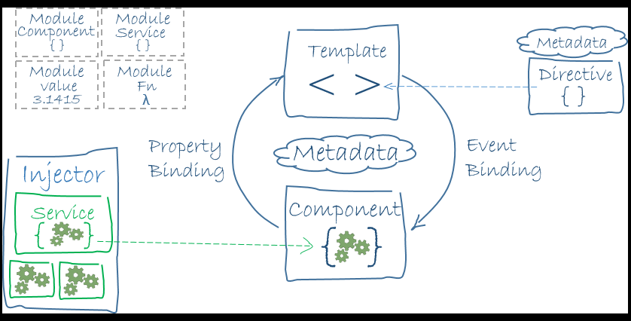
Big Picture

Slide 11
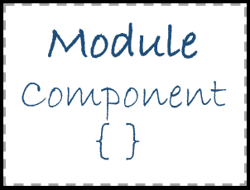
Modules
Angular apps are modular and Angular has its own modularity system called Angular modules or NgModules.
Every Angular app has at least one Angular module class, the root module, conventionally named AppModule.
An Angular module, whether a root or feature, is a class with an @NgModule decorator.

Slide 12
NgModule
NgModule is a decorator function that takes a single metadata object whose properties describe the module. The most important properties are:
declarations -
the view classes that belong to this module. Angular has three kinds of view classes: components, directives, and pipes.
exports -
the subset of declarations that should be visible and usable in the component templates of other modules.
imports -
other modules whose exported classes are needed by component templates declared in this module.
providers -
creators of services that this module contributes to the global collection of services; they become accessible in all parts of the app.
bootstrap -
the main application view, called the root component, that hosts all other app views. Only the root module should set this bootstrap property.

Slide 13
bootstrapping root module.
Launch an application by bootstrapping its root module. During development you're likely to bootstrap the AppModule in a main.ts file like this one.

Slide 14
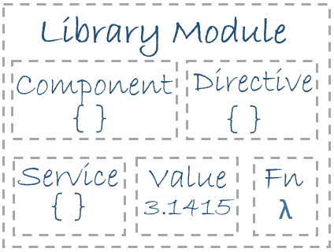
Angular libraries
Angular ships as a collection of JavaScript modules. You can think of them as library modules.
Each Angular library name begins with the @angular prefix.
You install them with the npm package manager and import parts of them with JavaScript import statements.
Import { Component } from '@angular/core';

Slide 15
Components
A component controls a patch of screen called a view.
Angular creates, updates, and destroys components as the user moves through the application. Your app can take action at each moment in this lifecycle through optional lifecycle hooks, like ngOnInit()
You define a component's view with its companion template. A template is a form of HTML that tells Angular how to render the component.

Slide 16

Directives
Angular templates are dynamic. When Angular renders them, it transforms the DOM according to the instructions given by directives.
A directive is a class with a @Directive decorator. A component is a directive-with-a-template; a @Component decorator is actually a @Directive decorator extended with template-oriented features.
Structural directives alter layout by adding, removing, and replacing elements in DOM. *ngFor, *ngIf
Attribute directives alter the appearance or behavior of an existing element. In templates they look like regular HTML attributes, hence the name.
<input [(ngModel)]="hero.name“ title=“”>

Slide 17
Services
Service is a broad category encompassing any value, function, or feature that your application needs.
Almost anything can be a service. A service is typically a class with a narrow, well-defined purpose. It should do something specific and do it well.
Examples include:
logging service
data service
message bus
tax calculator
application configuration

Slide 18
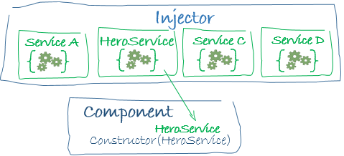
Dependency injection
Dependency injection is a way to supply a new instance of a class with the fully-formed dependencies it requires. Most dependencies are services. Angular uses dependency injection to provide new components with the services they need

Slide 19
Installation Methods
From scratch.
Using the quickstart angular-seed. From github.
Angular-CLI tool. Npm install –g angular-cli.
Required tools. NPM, Node, Git.
-----------------------------------
Quickstart project files overview. Package.json, Application bootstrap.

Slide 20
Reactive Forms
Angular reactive forms facilitate a reactive style of programming that favors explicit management of the data flowing between a non-UI data model (typically retrieved from a server) and a UI-oriented form model that retains the states and values of the HTML controls on screen. Reactive forms offer the ease of using reactive patterns, testing, and validation.
You create and manipulate form control objects directly in the component class. As the component class has immediate access to both the data model and the form control structure, you can push data model values into the form controls and pull user-changed values back out. The component can observe changes in form control state and react to those changes.
A FormControl constructor accepts three, optional arguments: the initial data value, an array of validators, and an array of async validators.
To let Angular know that this is the input that you want to associate to the name FormControl in the class, you need [formControl]="name" in the template on the <input>.

